Slide 1


Lecture 6:
Functions, Modules and Recursion
CoTaPP: Computational Thinking and
Programming with Python
All icons by: https://www.flaticon.com/

Slide 2






Slide 3

Previous lecture
Loops (repetitive behavior):
  while
  for
  break
  continue
Post-test loops in Python

Slide 4



Slide 5
Today’s lecture
Functions, modules and packages
  functions allow you to reuse already existing functionality (rather than implementing it again)
  modules and packages allows you to logically organize your Python code
Recursion
  A method of solving a computational problem where the solution depends on solutions to smaller instances of the same problem

Slide 6
Today’s lecture
Functions, modules and packages
  functions allow you to reuse already existing functionality (rather than implementing it again)
  modules and packages allows you to logically organize your Python code
Recursion
  a method of solving a computational problem where the solution depends on solutions to smaller instances of the same problem

Slide 7

Today’s lecture
Functions, modules and packages
  functions allow you to reuse already existing functionality (rather than implementing it again)
  modules and packages allows you to logically organize your Python code
Recursion
  a method of solving a computational problem where the solution depends on solutions to smaller instances of the same problem

Slide 8


Slide 9
Recursion

Slide 10
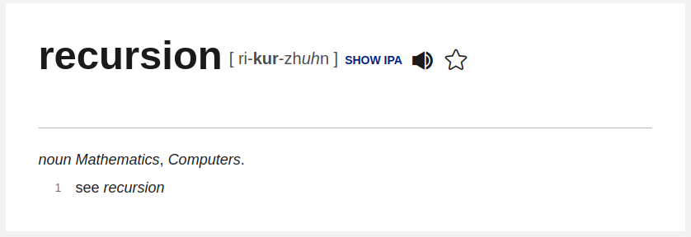

Slide 11
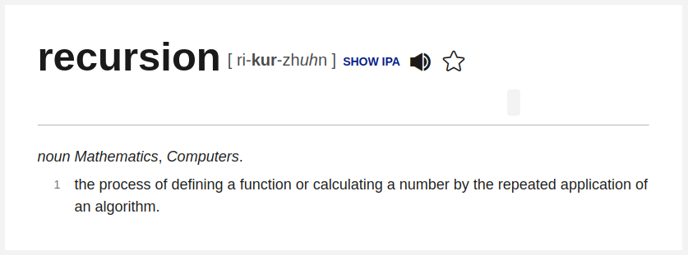

Slide 12
Example
For example, let's look at a recursive definition of a person's ancestors:
  One's parents are one's ancestors
  The parents of any ancestor are also ancestors of the person under consideration

Slide 13
Recursion
In computer science, recursion is a programming technique using a function that calls itself one or more times until a specified condition is met at which time the rest of each repetition is processed from the last one called to the first

Slide 14
Recursive definitions from mathematics
Power (or exponentiation)

Slide 15

Recursive definitions from mathematics
Power (or exponentiation)
  non-recursive definition
    3⁵ = 3 * 3 * 3 * 3 * 3 = 243

Slide 16
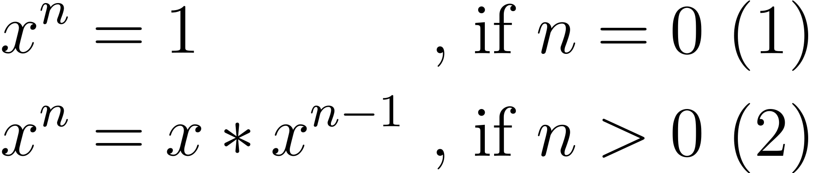
Recursive definitions from mathematics
Power (or exponentiation)
  non-recursive definition
    3⁵ = 3 * 3 * 3 * 3 * 3 = 243
  recursive definition

Slide 17
Recursive definitions from mathematics
3⁵ = 3 * 3⁴
  = 3 * 3 * 3³
  = 3 * 3 * 3 * 3²
  = 3 * 3 * 3 * 3 * 3¹
  = 3 * 3 * 3 * 3 * 3 * 3⁰
  = 3 * 3 * 3 * 3 * 3 * 1
  = 3 * 3 * 3 * 3 * 3
  = 3 * 3 * 3 * 9
  = 3 * 3 * 27
  = 3 * 81
  = 243

Slide 18
Recursive definitions from mathematics
3⁵ = 3 * 3⁴
  = 3 * 3 * 3³
  = 3 * 3 * 3 * 3²
  = 3 * 3 * 3 * 3 * 3¹
  = 3 * 3 * 3 * 3 * 3 * 3⁰
  = 3 * 3 * 3 * 3 * 3 * 1
  = 3 * 3 * 3 * 3 * 3
  = 3 * 3 * 3 * 9
  = 3 * 3 * 27
  = 3 * 81
  = 243

Slide 19
Recursive definitions from mathematics
3⁵ = 3 * 3⁴
  = 3 * 3 * 3³
  = 3 * 3 * 3 * 3²
  = 3 * 3 * 3 * 3 * 3¹
  = 3 * 3 * 3 * 3 * 3 * 3⁰
  = 3 * 3 * 3 * 3 * 3 * 1
  = 3 * 3 * 3 * 3 * 3
  = 3 * 3 * 3 * 9
  = 3 * 3 * 27
  = 3 * 81
  = 243

Slide 20
Recursive definitions from mathematics
3⁵ = 3 * 3⁴
  = 3 * 3 * 3³
  = 3 * 3 * 3 * 3²
  = 3 * 3 * 3 * 3 * 3¹
  = 3 * 3 * 3 * 3 * 3 * 3⁰
  = 3 * 3 * 3 * 3 * 3 * 1
  = 3 * 3 * 3 * 3 * 3
  = 3 * 3 * 3 * 9
  = 3 * 3 * 27
  = 3 * 81
  = 243

Slide 21
Recursive definitions from mathematics
3⁵ = 3 * 3⁴
  = 3 * 3 * 3³
  = 3 * 3 * 3 * 3²
  = 3 * 3 * 3 * 3 * 3¹
  = 3 * 3 * 3 * 3 * 3 * 3⁰
  = 3 * 3 * 3 * 3 * 3 * 1
  = 3 * 3 * 3 * 3 * 3
  = 3 * 3 * 3 * 9
  = 3 * 3 * 27
  = 3 * 81
  = 243

Slide 22
Recursive definitions from mathematics
3⁵ = 3 * 3⁴
  = 3 * 3 * 3³
  = 3 * 3 * 3 * 3²
  = 3 * 3 * 3 * 3 * 3¹
  = 3 * 3 * 3 * 3 * 3 * 3⁰
  = 3 * 3 * 3 * 3 * 3 * 1
  = 3 * 3 * 3 * 3 * 3
  = 3 * 3 * 3 * 9
  = 3 * 3 * 27
  = 3 * 81
  = 243

Slide 23
Recursive definitions from mathematics
3⁵ = 3 * 3⁴
  = 3 * 3 * 3³
  = 3 * 3 * 3 * 3²
  = 3 * 3 * 3 * 3 * 3¹
  = 3 * 3 * 3 * 3 * 3 * 3⁰
  = 3 * 3 * 3 * 3 * 3 * 1
  = 3 * 3 * 3 * 3 * 3
  = 3 * 3 * 3 * 9
  = 3 * 3 * 27
  = 3 * 81
  = 243

Slide 24
Recursive definitions from mathematics
3⁵ = 3 * 3⁴
  = 3 * 3 * 3³
  = 3 * 3 * 3 * 3²
  = 3 * 3 * 3 * 3 * 3¹
  = 3 * 3 * 3 * 3 * 3 * 3⁰
  = 3 * 3 * 3 * 3 * 3 * 1
  = 3 * 3 * 3 * 3 * 3
  = 3 * 3 * 3 * 9
  = 3 * 3 * 27
  = 3 * 81
  = 243

Slide 25
Recursive definitions from mathematics
3⁵ = 3 * 3⁴
  = 3 * 3 * 3³
  = 3 * 3 * 3 * 3²
  = 3 * 3 * 3 * 3 * 3¹
  = 3 * 3 * 3 * 3 * 3 * 3⁰
  = 3 * 3 * 3 * 3 * 3 * 1
  = 3 * 3 * 3 * 3 * 3
  = 3 * 3 * 3 * 9
  = 3 * 3 * 27
  = 3 * 81
  = 243

Slide 26
Recursive definitions from mathematics
3⁵ = 3 * 3⁴
  = 3 * 3 * 3³
  = 3 * 3 * 3 * 3²
  = 3 * 3 * 3 * 3 * 3¹
  = 3 * 3 * 3 * 3 * 3 * 3⁰
  = 3 * 3 * 3 * 3 * 3 * 1
  = 3 * 3 * 3 * 3 * 3
  = 3 * 3 * 3 * 9
  = 3 * 3 * 27
  = 3 * 81
  = 243

Slide 27
Recursive definitions from mathematics
3⁵ = 3 * 3⁴
  = 3 * 3 * 3³
  = 3 * 3 * 3 * 3²
  = 3 * 3 * 3 * 3 * 3¹
  = 3 * 3 * 3 * 3 * 3 * 3⁰
  = 3 * 3 * 3 * 3 * 3 * 1
  = 3 * 3 * 3 * 3 * 3
  = 3 * 3 * 3 * 9
  = 3 * 3 * 27
  = 3 * 81
  = 243

Slide 28
Recursive definitions from mathematics
3⁵ = 3 * 3⁴
  = 3 * 3 * 3³
  = 3 * 3 * 3 * 3²
  = 3 * 3 * 3 * 3 * 3¹
  = 3 * 3 * 3 * 3 * 3 * 3⁰
  = 3 * 3 * 3 * 3 * 3 * 1
  = 3 * 3 * 3 * 3 * 3
  = 3 * 3 * 3 * 9
  = 3 * 3 * 27
  = 3 * 81
  = 243

Slide 29
Recursive definitions from mathematics
3⁵ = 3 * 3⁴
  = 3 * 3 * 3³
  = 3 * 3 * 3 * 3²
  = 3 * 3 * 3 * 3 * 3¹
  = 3 * 3 * 3 * 3 * 3 * 3⁰
  = 3 * 3 * 3 * 3 * 3 * 1
  = 3 * 3 * 3 * 3 * 3
  = 3 * 3 * 3 * 9
  = 3 * 3 * 27
  = 3 * 81
  = 243
In computer science, recursion is a programming technique using a function that calls itself one or more times until a specified condition is met at which time the rest of each repetition is processed from the last one called to the first

Slide 30
Recursive definitions from mathematics
3⁵ = 3 * 3⁴
  = 3 * 3 * 3³
  = 3 * 3 * 3 * 3²
  = 3 * 3 * 3 * 3 * 3¹
  = 3 * 3 * 3 * 3 * 3 * 3⁰
  = 3 * 3 * 3 * 3 * 3 * 1
  = 3 * 3 * 3 * 3 * 3
  = 3 * 3 * 3 * 9
  = 3 * 3 * 27
  = 3 * 81
  = 243
In computer science, recursion is a programming technique using a function that calls itself one or more times until a specified condition is met at which time the rest of each repetition is processed from the last one called to the first

Slide 31
Recursive definitions from mathematics
3⁵ = 3 * 3⁴
  = 3 * 3 * 3³
  = 3 * 3 * 3 * 3²
  = 3 * 3 * 3 * 3 * 3¹
  = 3 * 3 * 3 * 3 * 3 * 3⁰
  = 3 * 3 * 3 * 3 * 3 * 1
  = 3 * 3 * 3 * 3 * 3
  = 3 * 3 * 3 * 9
  = 3 * 3 * 27
  = 3 * 81
  = 243
In computer science, recursion is a programming technique using a function that calls itself one or more times until a specified condition is met at which time the rest of each repetition is processed from the last one called to the first

Slide 32
Recursive definitions from mathematics
3⁵ = 3 * 3⁴
  = 3 * 3 * 3³
  = 3 * 3 * 3 * 3²
  = 3 * 3 * 3 * 3 * 3¹
  = 3 * 3 * 3 * 3 * 3 * 3⁰
  = 3 * 3 * 3 * 3 * 3 * 1
  = 3 * 3 * 3 * 3 * 3
  = 3 * 3 * 3 * 9
  = 3 * 3 * 27
  = 3 * 81
  = 243
In computer science, recursion is a programming technique using a function that calls itself one or more times until a specified condition is met at which time the rest of each repetition is processed from the last one called to the first

Slide 33
Recursion
A recursive function calls itself (2)
Notice that there's a case when the function does not call itself recursively (1)

Slide 34
Recursion
A recursive function usually has a certain structure:
  (1) one or more base cases, which does not call the function itself;
  (2) a recursive step, which calls the function itself and moves closer to the base case.
Usually, we solve the problem from n → 0 (or the base case), not from 0 → n

Slide 35
Recursion
Usually, we solve the problem from n → 0 (or the base case), not from 0 → n
Think of the base case, as the most simple scenario. For example, when the input is 0 or 1

Slide 36
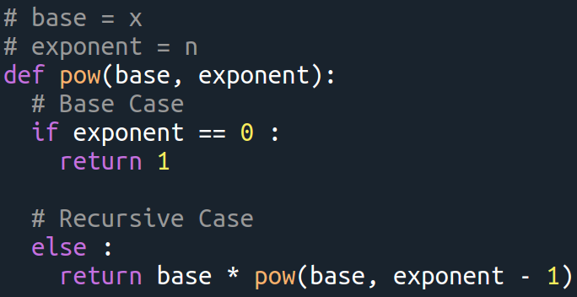

Slide 38
Write a recursive function to determine the sum of the first n natural numbers
sum(n) = 1 + 2 + 3 +……..+ n
sum(5) = 15
First, think about the base case and the recursive case. Then, write the function

Slide 39
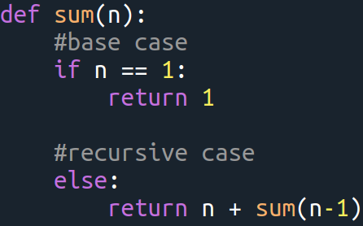

Slide 40
To Do
Exercises for the week
  Use quarterfall to submit them
Work in Project 1 (just a few more days)
MasteryGrids (practice practice practice)
  Textbook sections still not there
  Rest of examples and activities are there

Slide 41
Next lecture
Data structures in Python
  more powerful data items than just the individual values

Slide 42

Next lecture
Data structures in Python
  more powerful data items than just the individual values

